Slide 1
Coding Knowledge
Javascript API

Slide 2

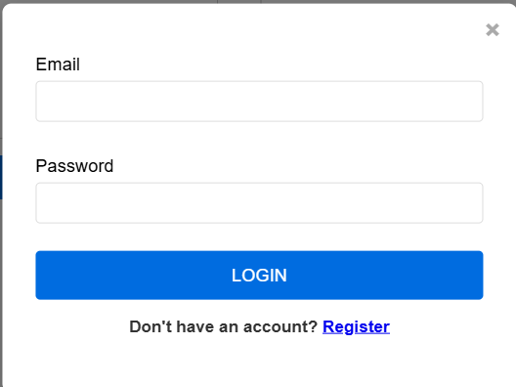

Introduction to APPs
User Interface
Database
API

Slide 3
Introduction to APPs
Client Side
User interface design (UI/UX).
Client-side validation (form inputs).
Static content delivery (images, stylesheets).
Local data storage (cookies, local storage).
Server Side
Data Security: Sensitive data should not be exposed on the client-side.
Business Logic: Ensures core functionality of the app remains secure and consistent.
Database Operations: interactions with databases should occur on the server-side to protect data integrity.
Session Management: Handling user sessions to maintain state and secure interactions.

Slide 4
What is API ?
API definition Application Programming Interface, is a set of rules and protocols that allows different software applications to communicate with each other. Think of it as a bridge that enables different programs to share data and functionality and work together seamlessly.
Why Use API Security, Scalability, Flexibility
What we need to build an API Programming Language, IDE, Databases, Testing Tools
Apps A
Apps B
API
System
Apps …

Slide 5


What happened inside API ?
1. Validation:
Input validation checks whether the incoming data meets the required format & structure.
2. Authentication and Authorization:
Authentication verifies the identity of the user or application making the request Authorization checks if the authenticated user has permission to perform the action.
3. Transformation
If necessary, the API may transform or format incoming data to match internal models or structures that the application uses.
4. Business Logic Fetching or manipulating data from a database. Performing calculations or interacting with other services or APIs.
API

Slide 6
What is API Looks like ?
API URL https://example.com/customer?id=25&name=ari
API METHOD GET, POST, PUT, DELETE
API REQUEST Header, Body, Query Param
API RESPONSE Header, Body

Slide 7
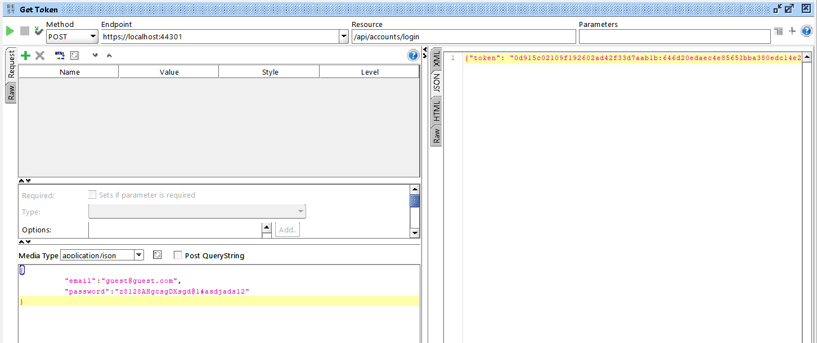
API sample 1

Slide 8
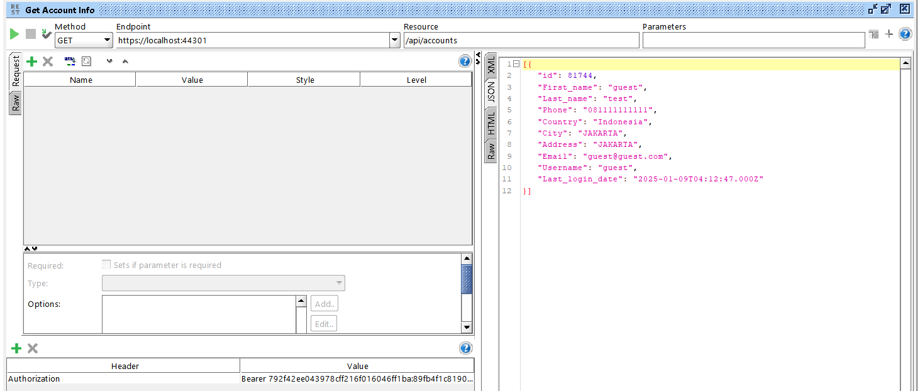
API sample 2

Slide 9
HOW to build CRUD api
Design Entity
Define Parameters
customer(id, first_name, last_name, phone, email, join_date)
product(id, product_name, stock, expired_date )

Slide 10
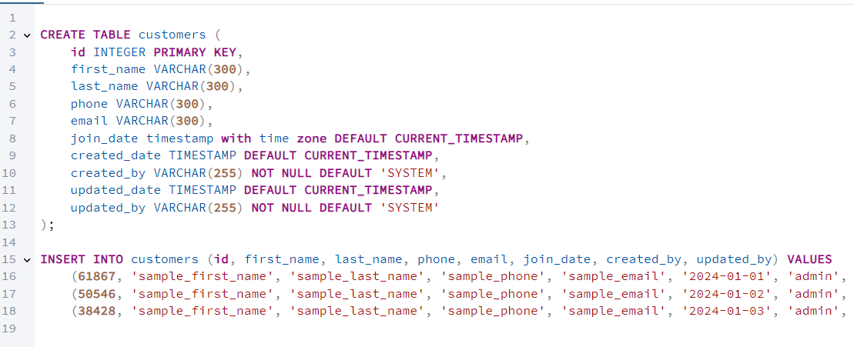
HOW to build CRUD api
Database
Design Database
Create Table
Insert Sample Data

Slide 11
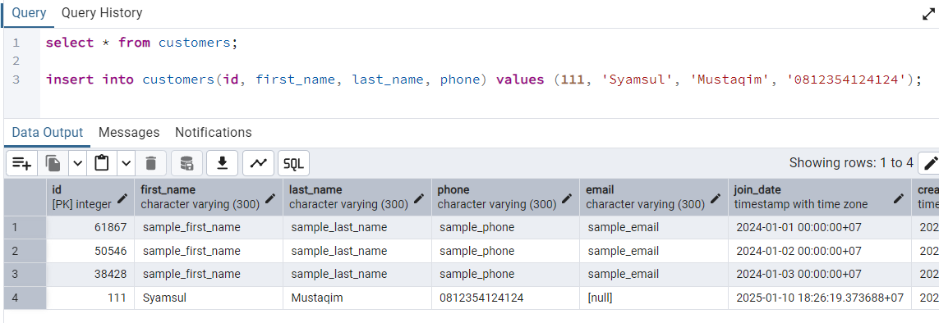
HOW to build CRUD api
Database
Select Sample Data
Update Sample Data
Delete Sample Data

Slide 12
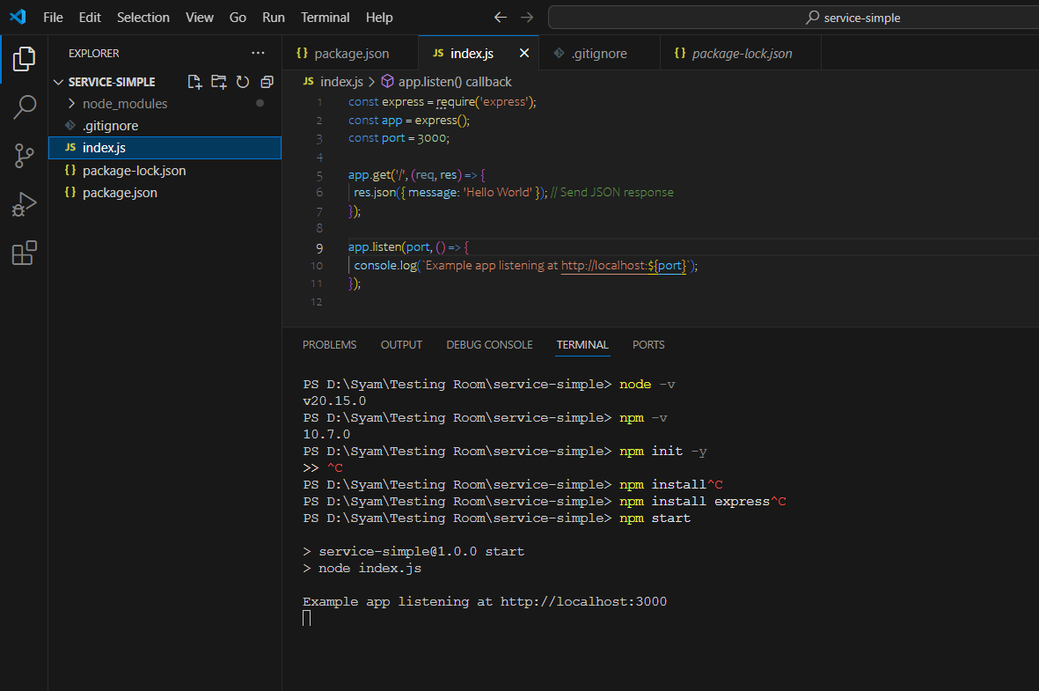
HOW to build CRUD api
Build simple API
Installation on VS Code
Lets import Express
Lets try hello world
Create a simple http listener

Slide 13
HOW to build CRUD api
Understand the folder structures
Index Its where we put the listener we initiate something we tell where the router is
Controller We define the router Passing thru message If necessary adding first layer of calidation
Flow We define business logic Adding second layer of validation Adding transformation or calculation
Repository This is where we actually call the backend if the backend is DB then this is where we define query if the backend is another API then we build function to call it
Apps A
API
Index
Controller
Flow
Database
Repository

Slide 14
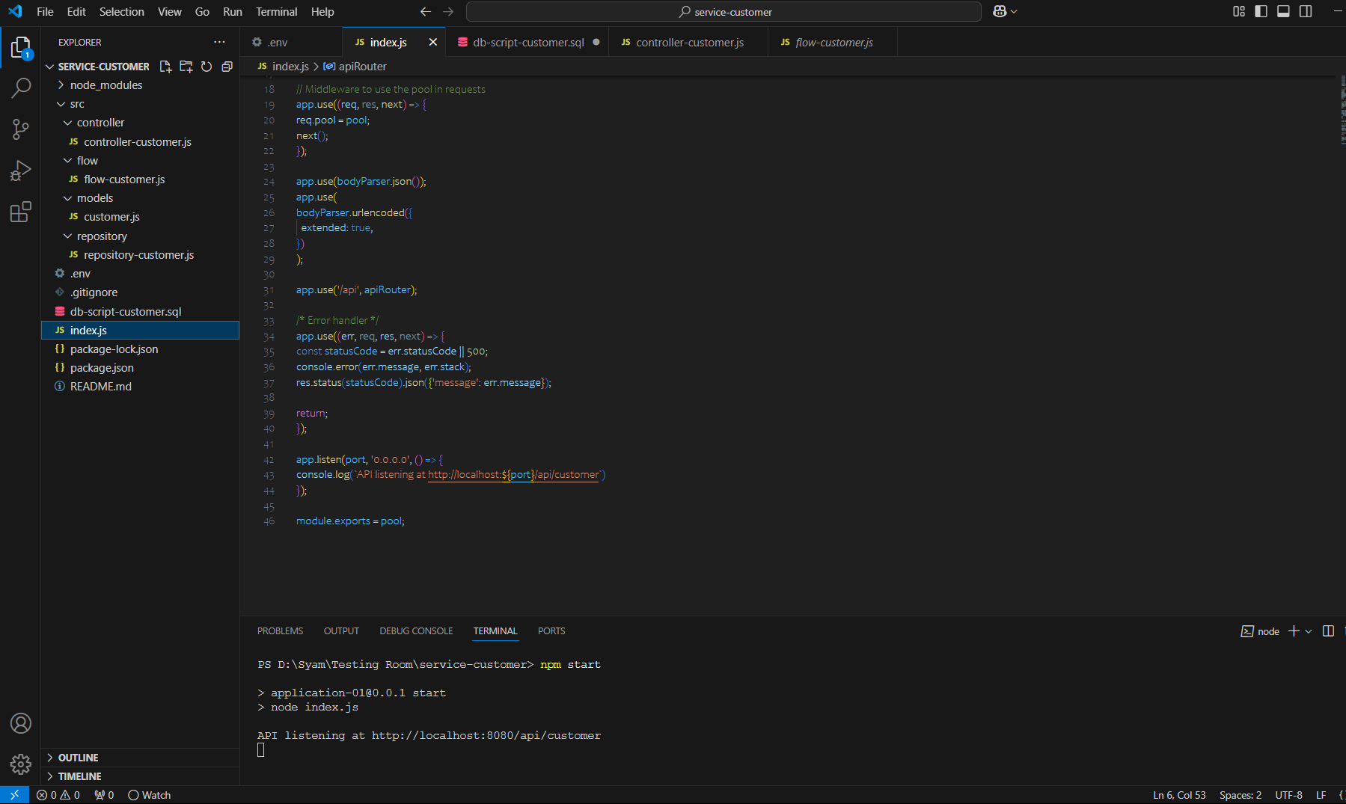
Sample Code Structure

Slide 15
Testing API
Test From Browser
Test from SOAPUI
Test with CURL
API

